Slide 1

IntelliStudy
Ministry Category : Ministry of HRD / Education & Skills
Problem Statement : Artificial Intelligence used system to identify the level of understanding and provide learning as per the requirements of the student.
Problem Code : #MHRD5
College Code : Institute of National Importance

Slide 2

Description of Idea
Objective
The objective is to use artificial intelligence to make the educational experience easier, better and more effective. A system that takes care of the needs of different students differently through the application of greater levels of individualized learning.
By providing an interface to students and mentors which enables them to subscribe, build up their profile, access the content of various courses (from High School to graduate schools), attempt quizzes, review progress, browse career paths, provide feedbacks which is essential for the evaluation of the system and improving the content.
The mentors can use the same interface for checking the feedback and updating the course material accordingly the mentors can solve the problems of the students.

Slide 3

Problems in current E-learning platforms.
1. Every Student is unique. Learning and information grasping varies from one Student to another.
2. Students are often confused about what sort of courses they must undertake in order to excel at their careers.
3. Lack in the Dynamicity of the courses. Courses currently are extremely hard-coded.
4. Non-maintenance of outdated Course material.

Slide 4

Our Solution: Intellistudy
Intellistudy focuses on students of variant backgrounds, helps them learn according to their intellect level and interests free of cost, as education cannot be sold.

Slide 5
















Tech Stack
Frontend
Backend
Database
Others

Slide 6
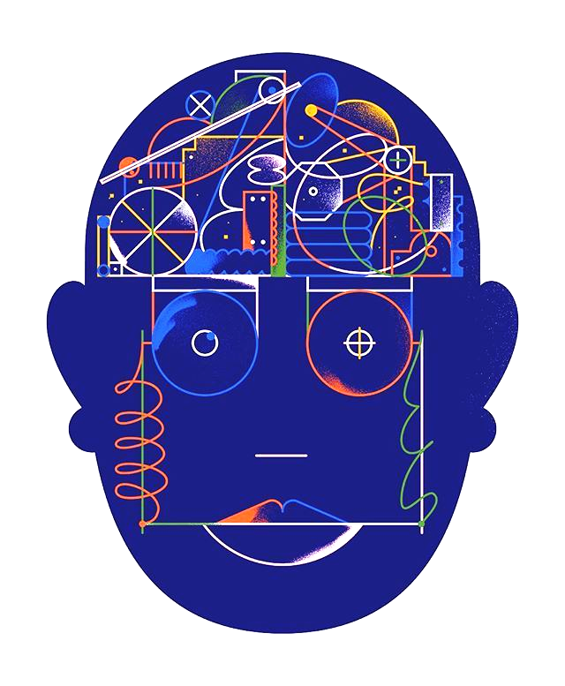
Why AI in Education?
Dynamic over Static.
Recommend what is Beneficial for a Student’s career. (User - User collaborative filtering)
Recommend what is Beneficial for following a particular career. (Collaborative filtering using Restricted Boltzmann Machines)
Molding questions to the understanding of the student for maximum growth. Learning about the student, using Artificial Neural Network (ANN)
1.
2.
3.
4.

Slide 7
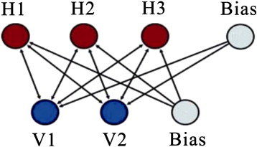
AI & ML in Intellistudy
Recommending Career Path.
For Recommending suitable careers, our model uses restricted Boltzmann Machine which have been stated to be computationally efficient for the dataset of a Hundred-Million entries.
Based on the courses the student has been enrolled in, suitable career paths and additional courses required for those paths are recommended.

Slide 8
AI & ML in Intellistudy
Recommending Courses
Providing User-User based collaborative filtering for recommending relevant courses to the student.
Based on the similarity of the scores between the users, the system recommends the most relevant courses suitable for the particular student.
These courses are divided into two categories – Easy and Challenging.

Slide 9
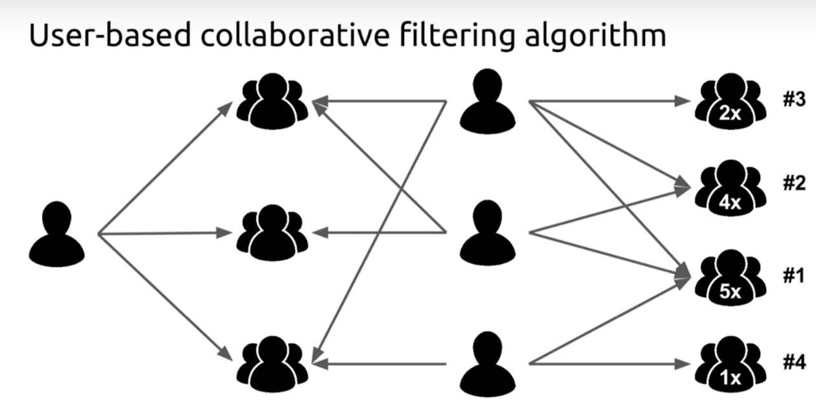

Slide 10
AI & ML in Intellistudy
Quizzes
3 Layered Neural networks to dynamically adjust the level of questions asked in the quizzes.
Factors into consideration:
Response time per question.
Correctness.
Average response time of all the other users.

Slide 11
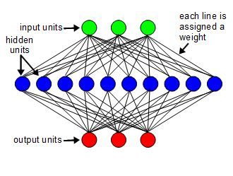
Learning Rate : 0.1
Number of hidden units: 10
Number of output units: 3
Number of input units between 1 to 10

Slide 12
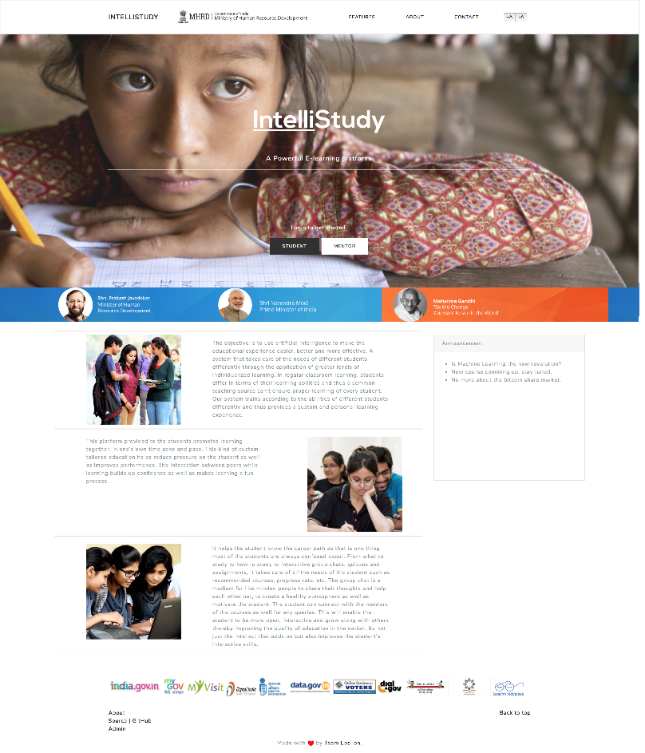
Index

Slide 13

Login

Slide 14

Sign up

Slide 15
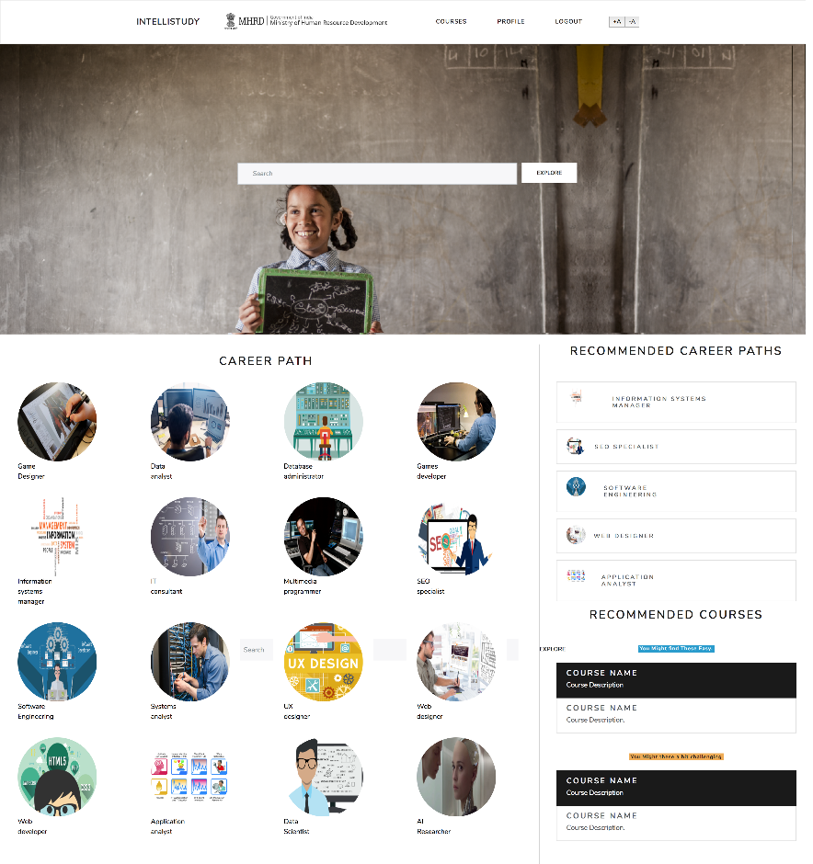
Student Dashboard

Slide 16
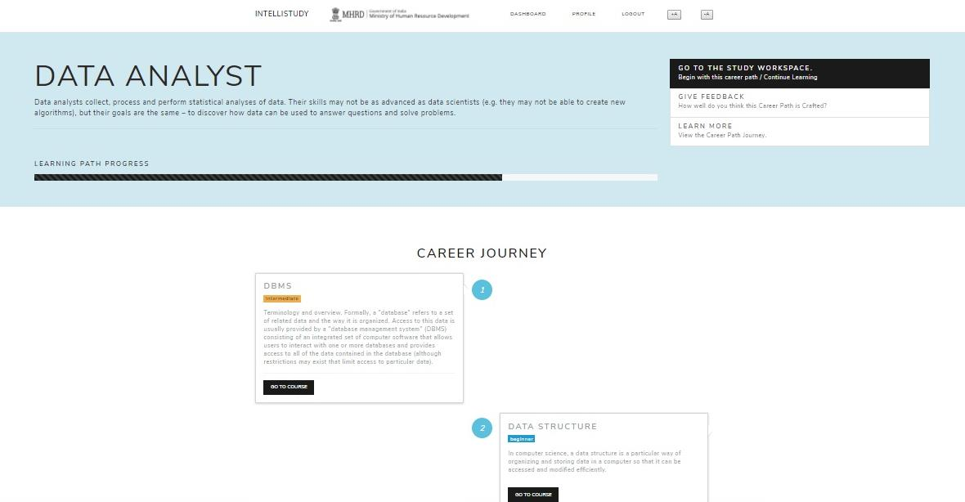
Career Path

Slide 17
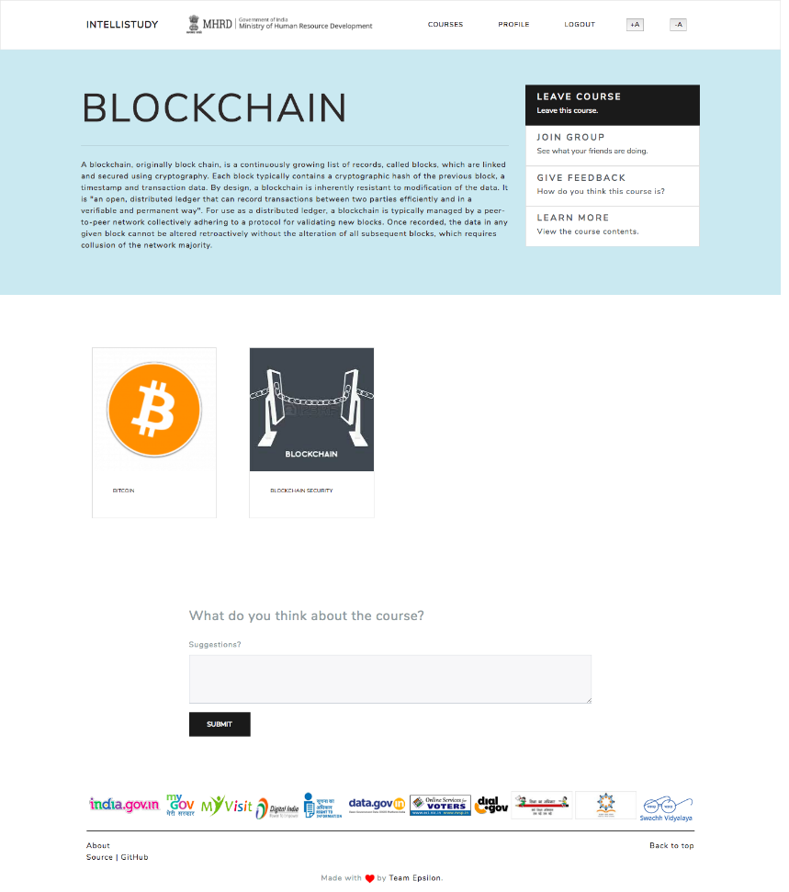
Course Main

Slide 18
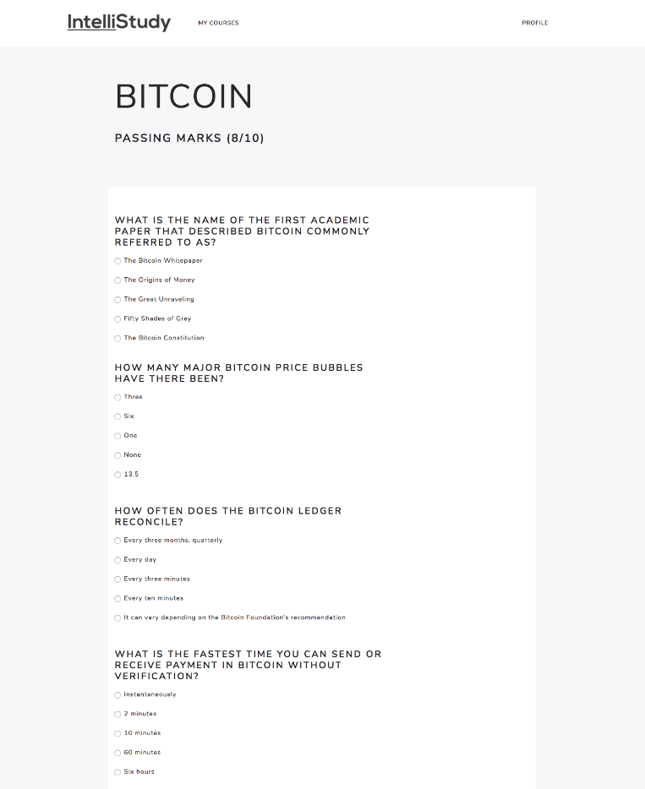
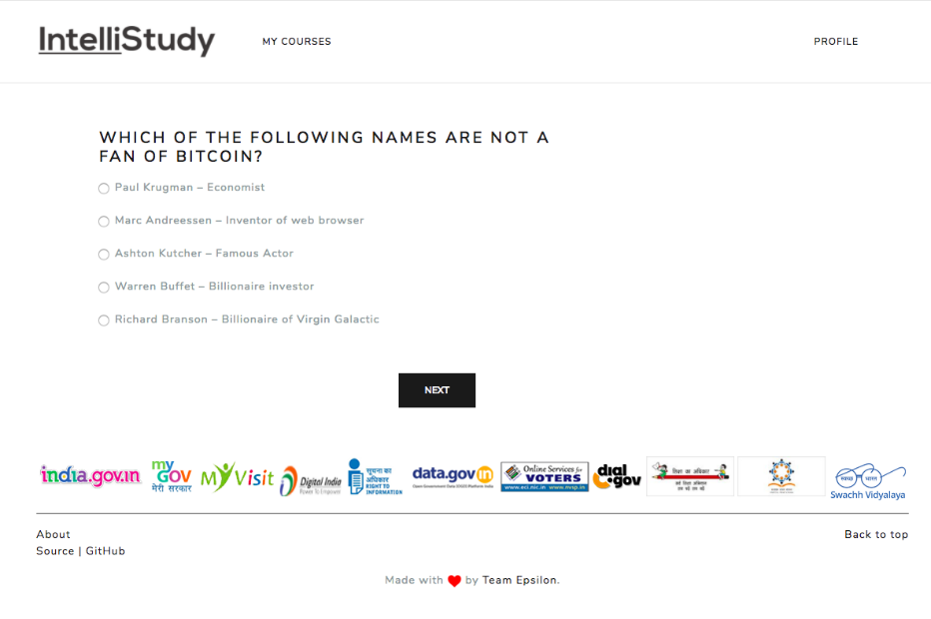
Quizzes

Slide 19
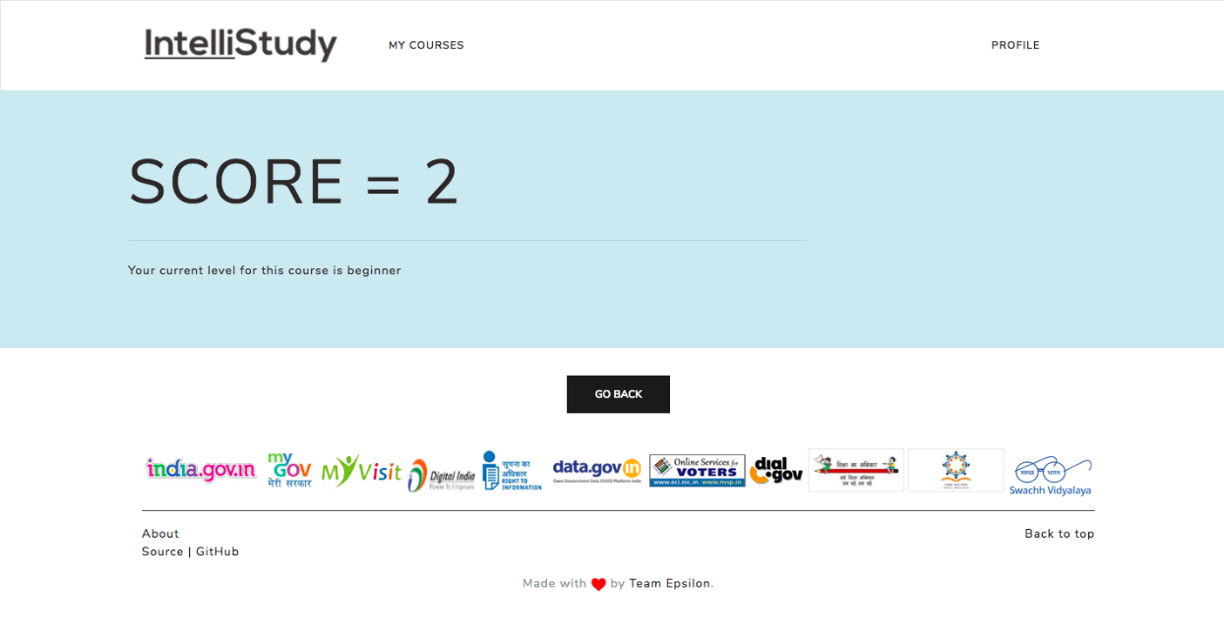
Quiz Results

Slide 20
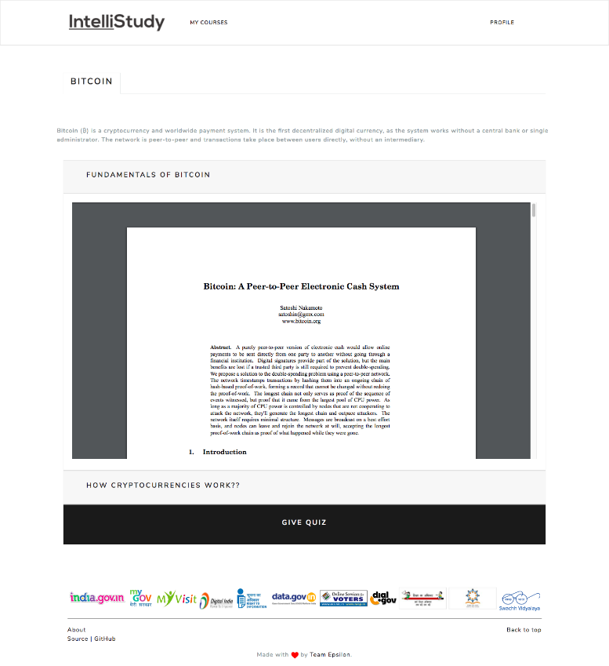
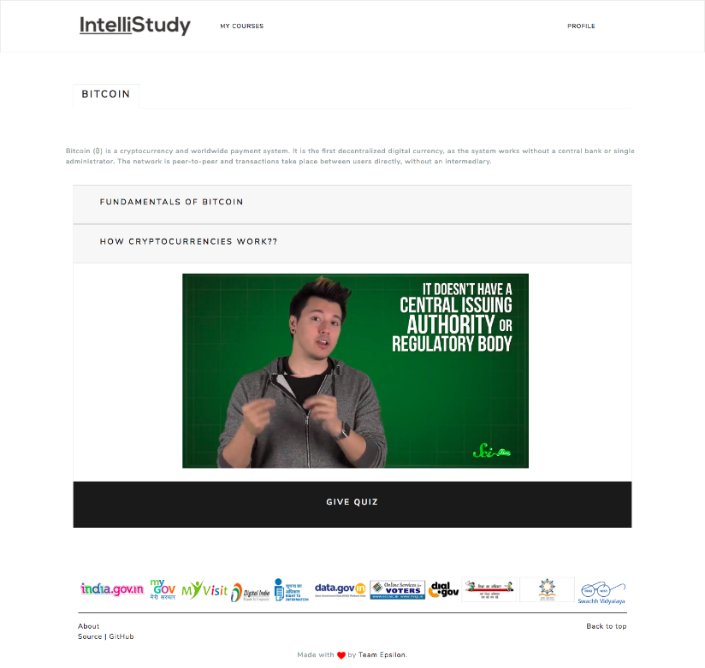
Course Study Page

Slide 21
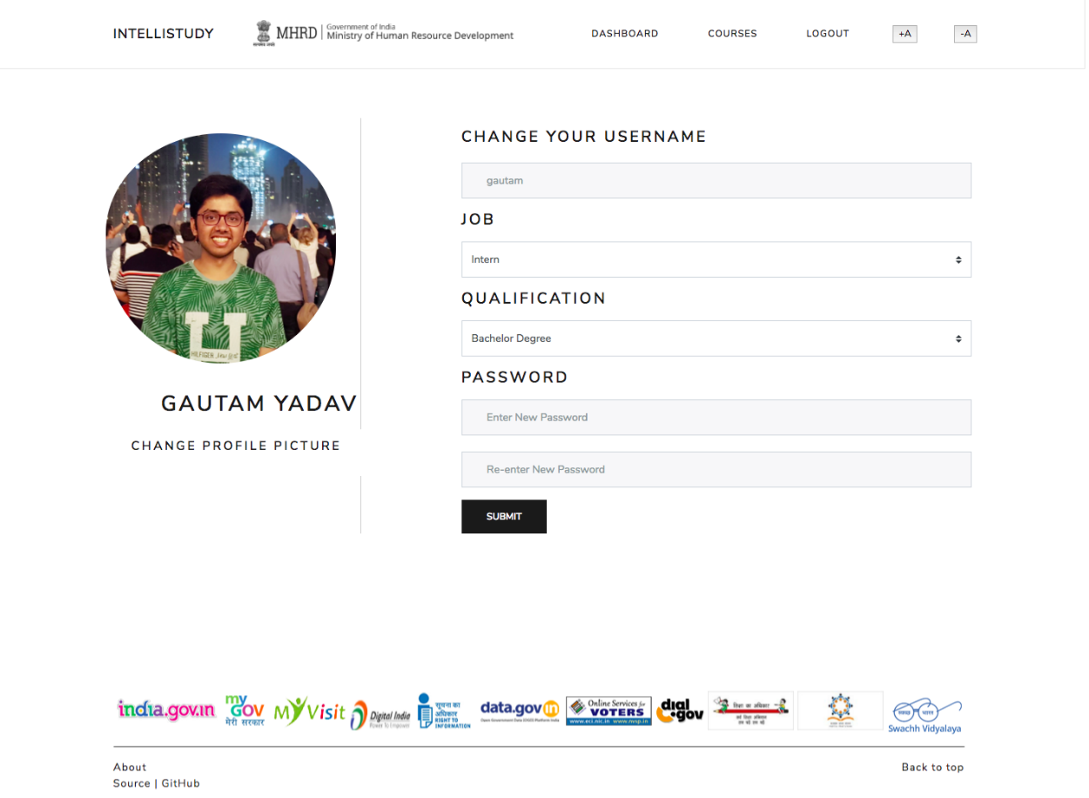
Profile Page

Slide 22
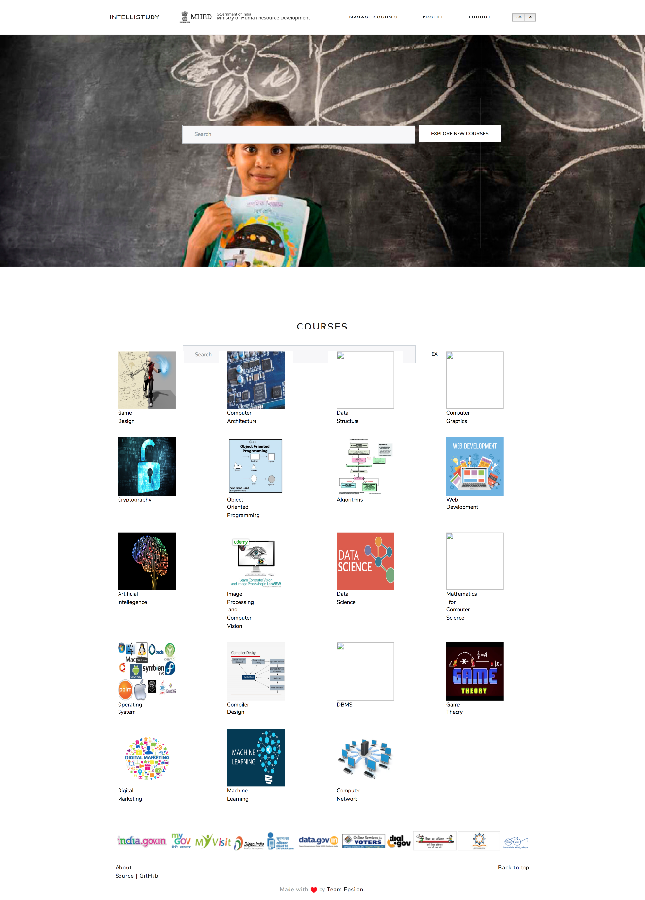
Mentor Dashboard

Slide 23
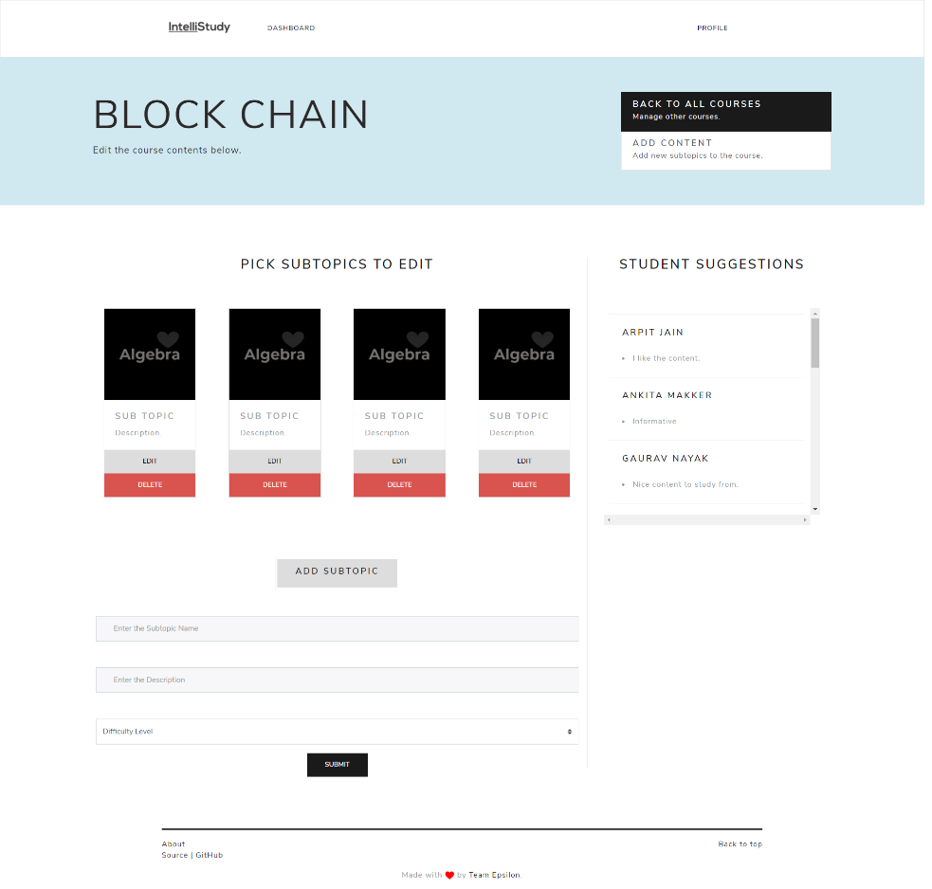
Course Editor

Slide 24
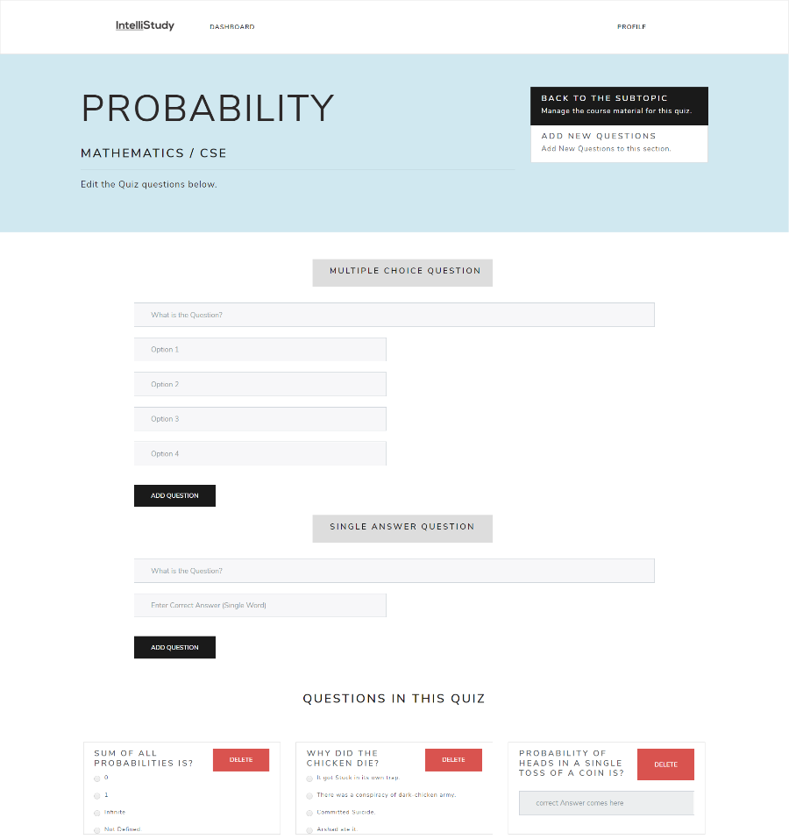
Edit Quiz for a course.

Slide 25
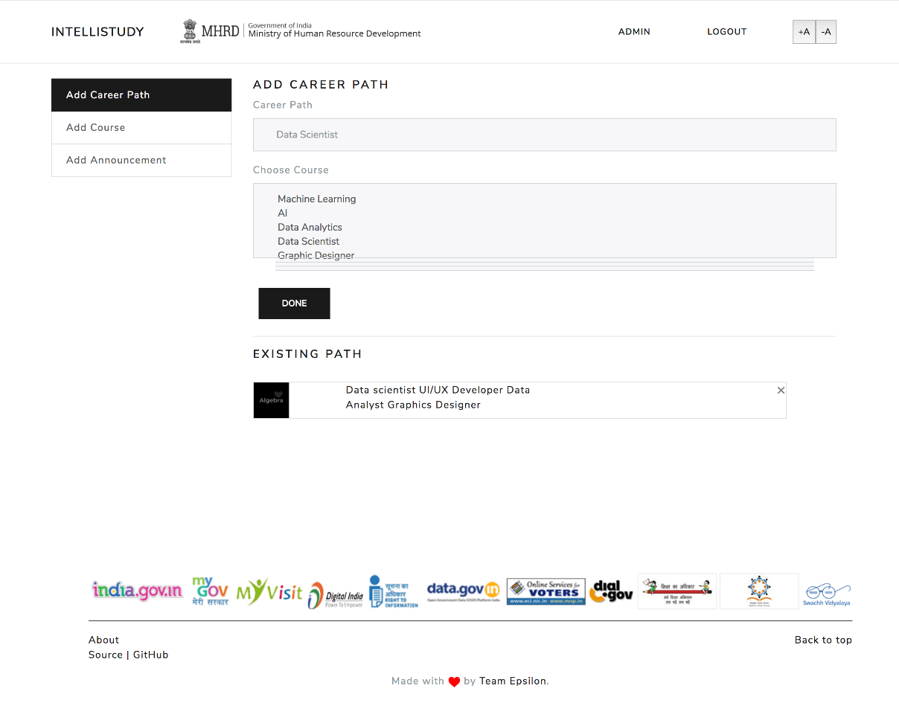
Admin Interface

Slide 26
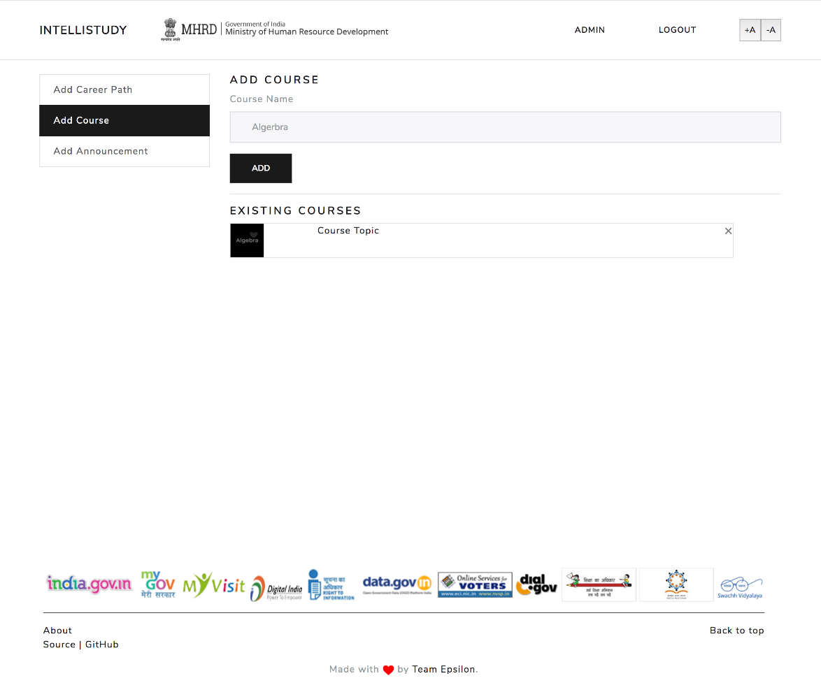
Admin Interface

Slide 27
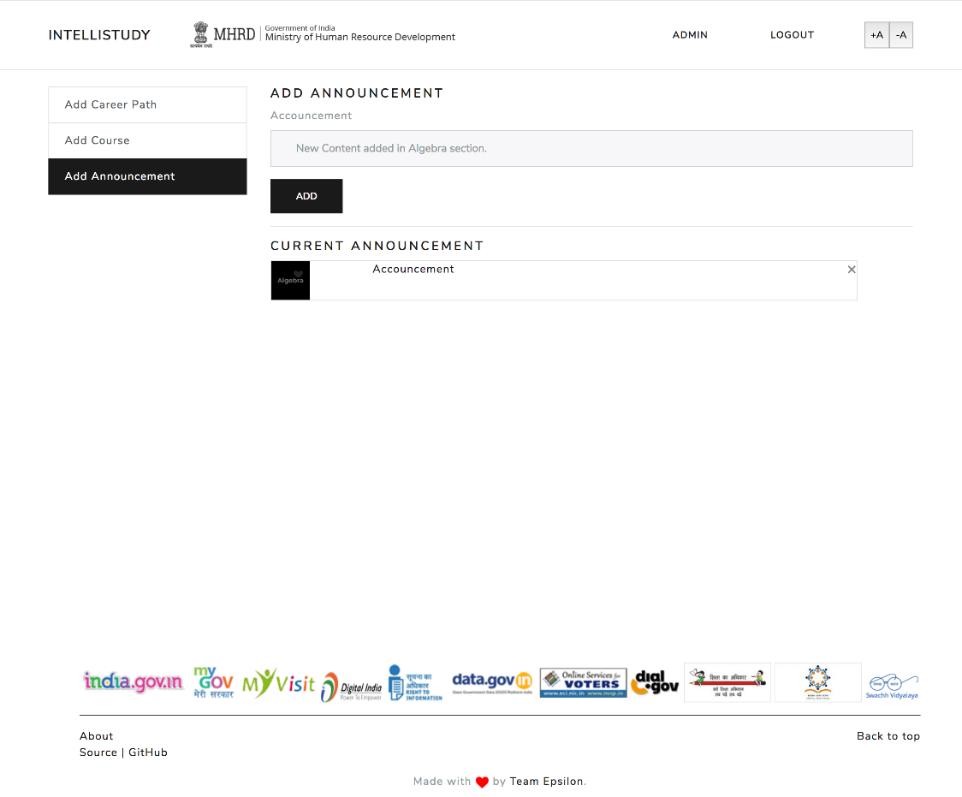
Admin Interface

Slide 28

Final Verdict
“This platform provided to the students promotes learning together, in one’s own time zone and pace.
This kind of custom-tailored education helps reduce pressure on the student as well as improves performance by personalizing the platform as per their caliber.
Its recommending systems help remove the confusion that the young minds mostly face by helping them choose the courses that can help them choose their right career path.

Slide 29
Commercial Viability
Different Approach - Intellistudy doesn’t mold the student according to the structure of the course.
Always free of cost - Intellistudy uses all the open-source technologies. Education must always be free of cost.
Diversity – Intellistudy is extremely versatile and dynamic and thus can be extended to all age-groups as well as cultures.
I

Slide 30

Thankyou

